Slide 1
Predicting Stock price using Machine learning: Tesla
Group 22 :
Jayant Kumar
Varun Kandhari
Angad Malhotra

Slide 2
Project Motivation
To Predict Tesla Stock Prices by incorporating the ARIMA model in Python
TSLA has seen a higher interest by investors in its stock
The growth of Tech Industries has made it essential to have accurate market prediction.

Slide 3
Methodology
Data Visualization - Visualising the data using graphs
Splitting the data - Splitting the data into Training and Test dataset
Running the ARIMA model on training data
Predicting the Closing Stock Price using the Test data
Analyzing the performance of the model

Slide 4
Data Source
We have collected the data of TSLA from Yahoo Finance.
https://finance.yahoo.com/quote/TSLA/

Slide 5
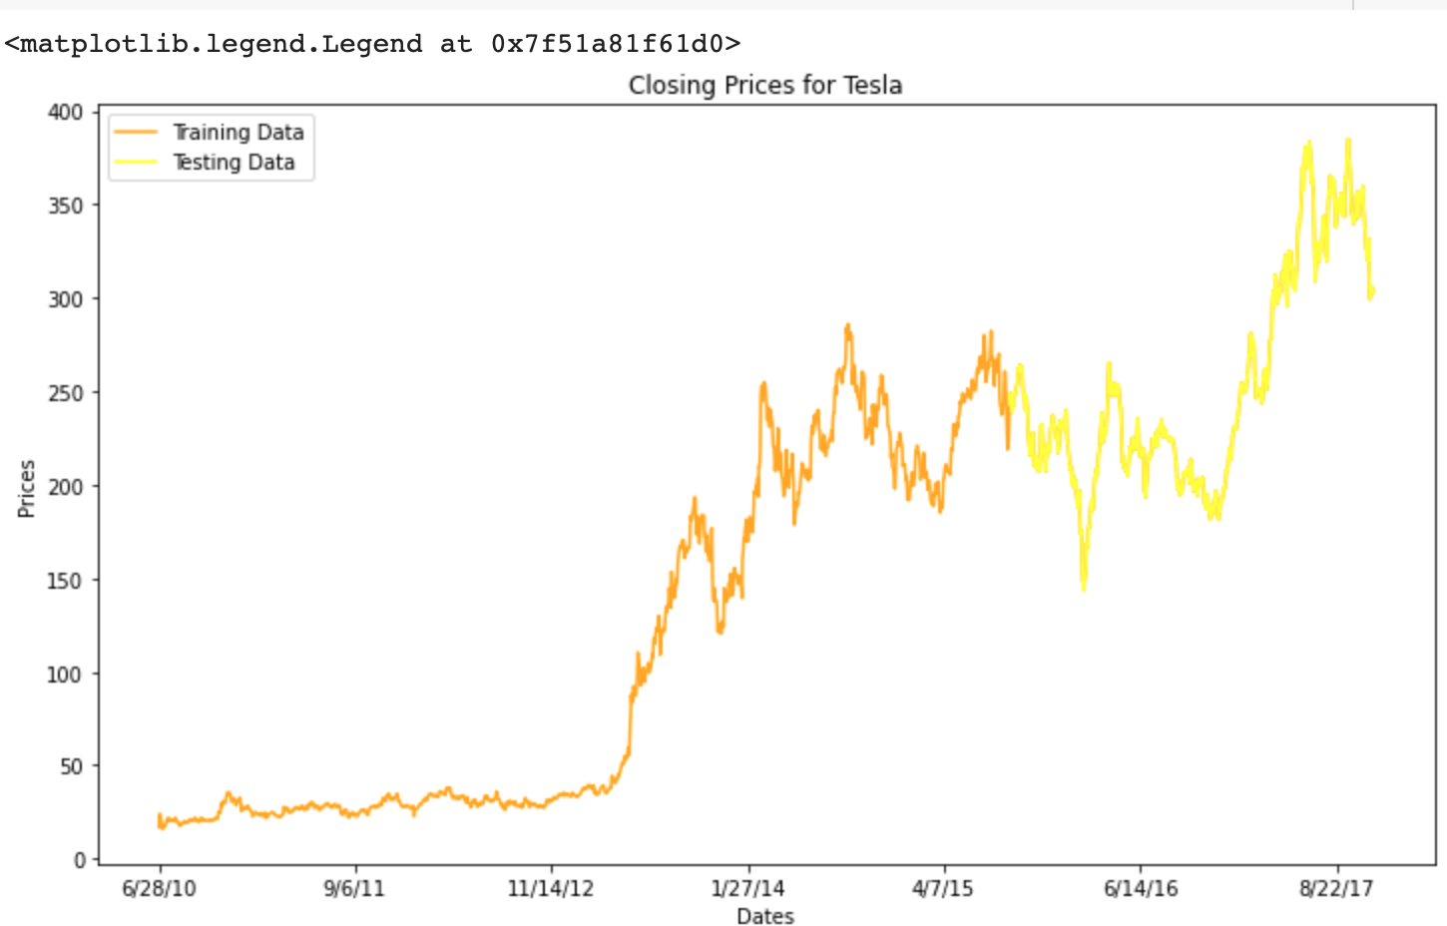
ARIMA Model
ARIMA is in short for Autoregressive Integrated Moving Average Model.
A combination of both the Autoregressive Model and Moving Average Model.
AR model - takes the lagged variables of itself
MA model - regresses the variable on shocks/epsilon.
Assumptions/Requirements:
Univariate Variable
Stationarity in Data
A non-stationary data should be made stationary using differencing.
Linearity in parameters

Slide 6
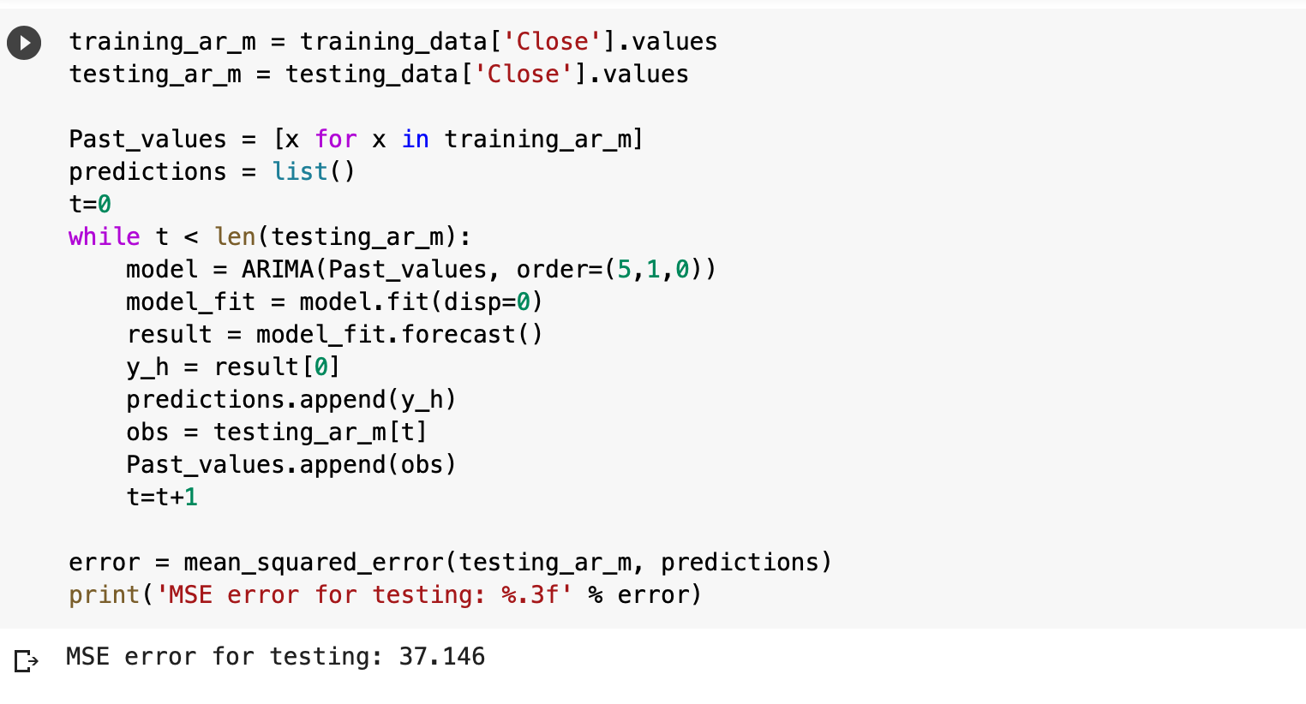
Results :

Slide 7
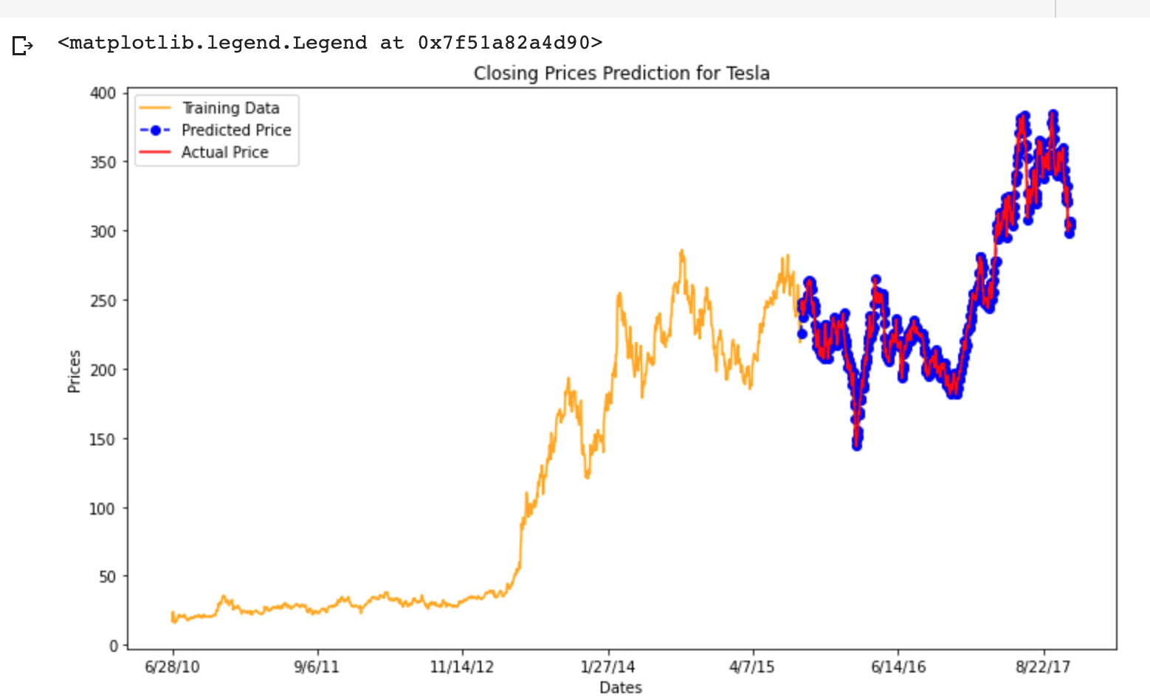

Slide 8
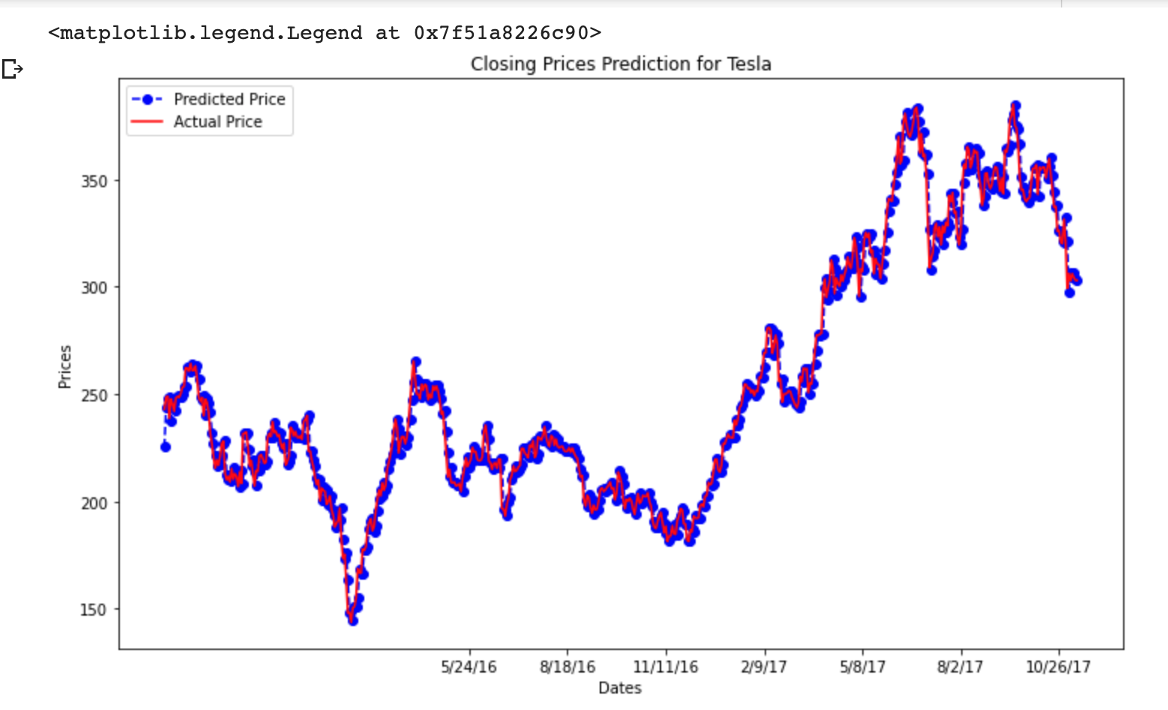

Slide 9
Thank You!

